Slide 1
Training activities PaNOSC WP8 – ExPaNDS WP5
11th November 2020
Authors: Thomas Holm Rod, Thibaud Cayla, Nazaré Guimard, Florian Gliksohn

Slide 2

Overview
Objectives, deliverables, dependencies
Common achievements of this year
Past and foreseen engagement with users
Next steps for the upcoming 12 months
Notes:
Objectives, deliverables, dependencies
Objectives
Gantt chart of the project
Deliverables
Impact and dependencies between the project and with the others WPs
Common achievements of this year:
Ongoing achievements on the e-learning platform (PaNOSC),
Report on FAIR workshop (ExPaNDS)
Amendment to align the activities between ExPaNDS and PaNOSC
Past and foreseen engagement with users:
presentation of the future training portal that will aggregate a calendar showing the upcoming training events, an aggregator of existing and future training materials (external links) and an e-learning platform with computing capacities;
Highlight of a workshop and dedicated to trainers for the adoption of the training platform
Roadmap of the upcoming 12 months
Sustainability: future contacts with the stakeholders, participation to training and skills TF
Technical developments: DevOps, what has to be done before Jupyter integration, platform for smart indexing
Identification of training needs and training material to be collected and created by PaNOSC and ExPaNDS: survey

Slide 3
Objectives, deliverables, dependencies

Slide 4


PaNOSC and ExPaNDS Training activities objectives
Provide an e-learning platform and service
Organize a series of training events
Provide training material
Provide an e-learning platform and service to provide training to staff and users
Provide training material
accessible to staff and users from national RIs
using EOSC data websites and e-learning platforms
to use the e-learning platform
to develop courses, and train staff at relevant RIs at specific workshops
to promote the FAIR principles and best practices
to promote services and capabilities of PaN facilities
Organize a series of training events
data FAIR principles
data stewardship
data management
data analysis services integrated into the EOSC services
staff training on e-learning platform

Slide 5
PaNOSC and ExPaNDS GANTT chart
We are here
2018
2019
2020
2021
2022
2023
D
D
D
D
D
D
D
+6 months
D
D
D
D
D
Migration of the e-learning platform
FAIR workshop
e-Learning platform demonstrator
Content published on the training platform
Project | WP start | WP end | WP Leader | WP Co-Leader | Partners | Dependencies
PaNOSC | 01/12/2018 | 30/11/2022 | Thomas Holm Rod (ESS) | Florian Gliksohn (ELI) | ESS, ELI, ESRF, XFEL, ILL, CERIC-ERIC | WP2, WP3, WP4, WP5, WP6
ExPaNDS | 01/08/2020 | 28/02/2023 | Thibaud Cayla, Nazaré Guimard (SOLEIL) | Uwe Konrad (HZDR) | SOLEIL, HZDR, EGI | WP2, WP3, WP4

Slide 6

PaNOSC and ExPaNDS Deliverables
Amendment to align the activities between ExPaNDS and PaNOSC
Project | Deliverable | Due Date | Status | Description
ExPaNDS | D5.1 | Aug 2020 | Done | Annual Report, year 1
PaNOSC | D8.1 | Jul 2021 | Pending | Report on lessons learned and future prospects for adopting best practices data stewardship
ExPaNDS | D5.2 | Aug 2021 | Pending | Annual Report, year 2
ExPaNDS | D5.4 | Sept 2021 | Pending | Demonstrator for using of e-learning platforms
PaNOSC | D8.2 | May 2022 | Pending | Report on lessons learned for adopting the e-learning platform
PaNOSC | D8.3 | May 2022 | Pending | Teaching material accessible in the e-learning platform
ExPaNDS | D5.3 | Aug 2022 | Pending | Annual Report, year 3
ExPaNDS | D5.5 | Aug 2022 (incl.+6 months) | Pending | Dedicated websites and e-platforms with the teaching materials
PaNOSC | D8.4 | Nov 2022 | Pending | Closing report including report from summer school
ExPaNDS | D5.6 | Jan 2023 (incl. +6 months) | Pending | Report on lessons learned and future prospects for adopting best practices

Slide 7
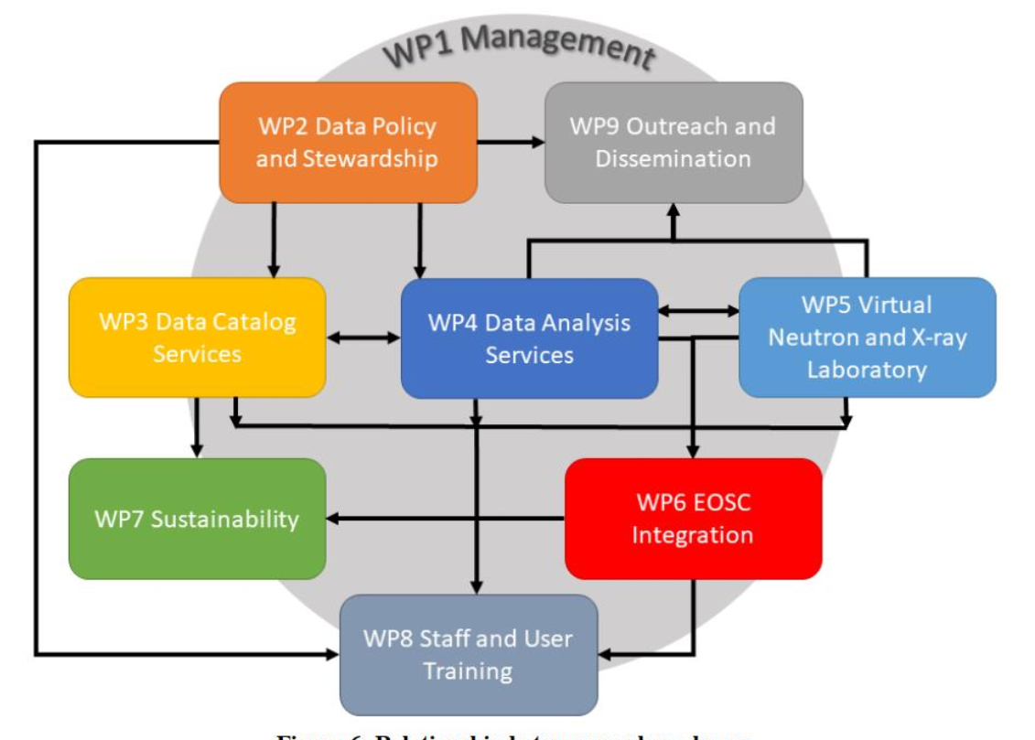
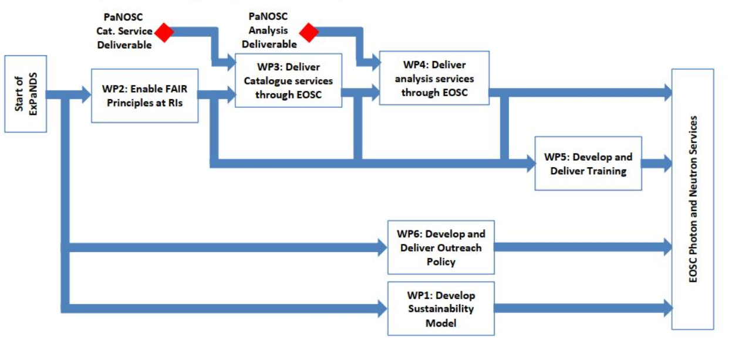
Dependencies with Technical and Outreach WPs
Input from ExPaNDS WP5 and PaNOSC WP8
Provide a training platform (PaNOSC) Provide guidelines to create training material Provide guidelines to use the training platform Collect and publish training material Organise training workshops and events
Input from other WPs
Define the training objectives Provide training material Identify training workshops and events to be organised Contribute to the adoption of the training platform

Slide 8
Coordination of ExPaNDS and PaNOSC training activities
ExPanDS/PaNOSC joint meetings
Training platform Task Force
Fredrik Bolmsten, ESS
Kareem Galal, ESS
Peter K. Willendrup, ESS
Sebastian Micluța-Câmpeanu, ELI
Teodor Ivănoaica, ELI
Lottie Greenwood, ESS
Jesper R. Selknaes, ESS
Objectives: PaNOSC WP8 and ExPaNDS WP5 monitoring
Objectives: Technical requirements for setting the training portal
Thomas H. Rod, ESS
Participants:
Alexandre Stefanov, ESS
Miguel Gonzalez, ILL
Vincent Favre-Nicolin, ESRF
Nicoletta Carboni, CERIC
Teodor Ivănoaica, ELI
Peter K. Willendrup, ESS
Thomas H. Rod, ESS
Thomas Kluyver, XFEL
Florian Gliksohn, ELI
Oliver Knodel, HZDR
Nazaré Guimard, SOLEIL
Thibaud Cayla, SOLEIL
Uwe Konrad, HZDR
Oliver Knodel, HZDR
Giuseppe La Rocca (EGI)
Participants:

Slide 9
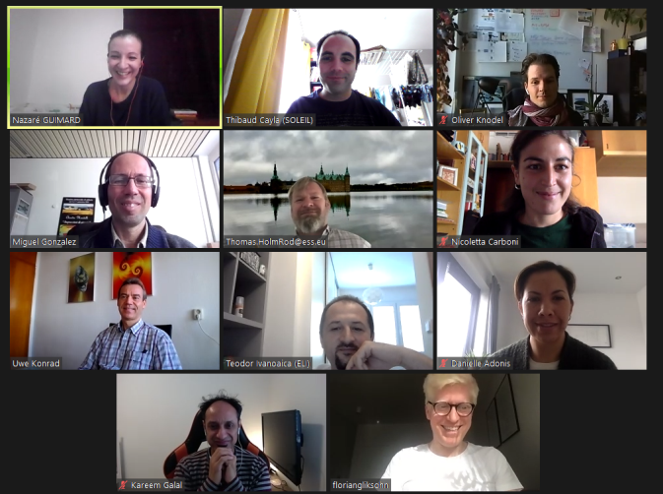

Slide 10
Common achievements of this year

Slide 11
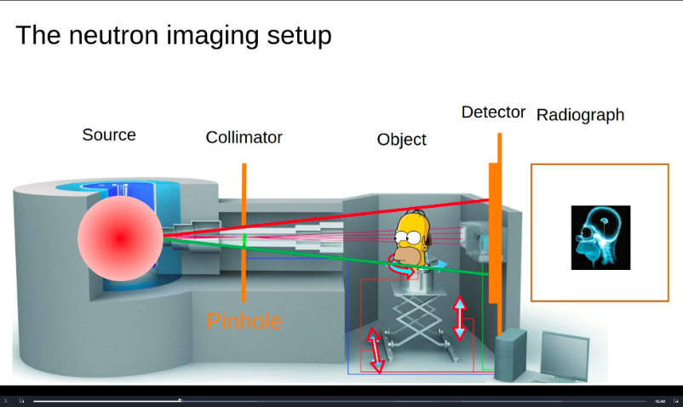
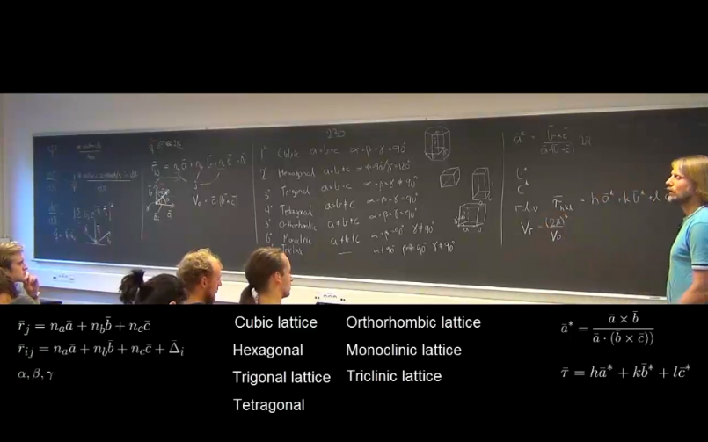
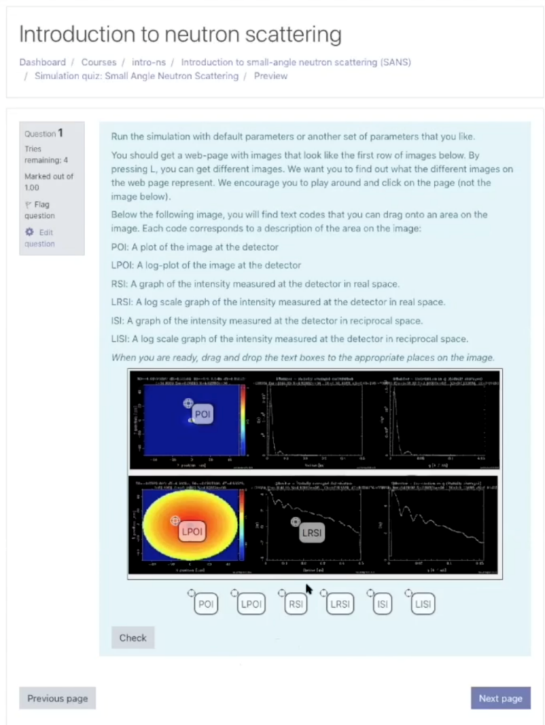





E-learning platform modules
Types of learning materials
Text book material
Quizzes
Slides
Videos
Annotated videos
Virtual experiments
Jupyter (scripting)
Components:
Work in progress:
+ other simulation software

Slide 12
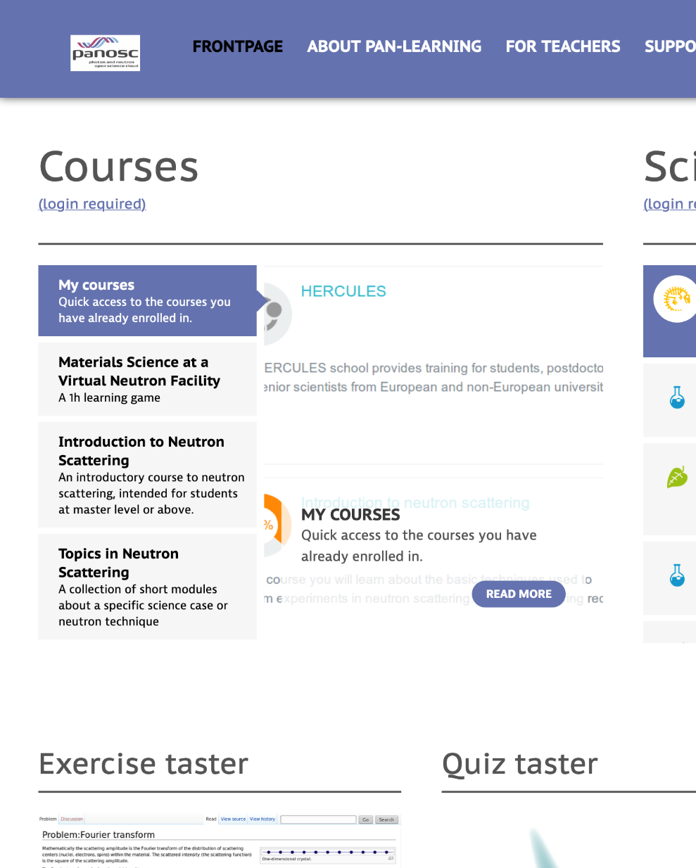



E-learning platform outcomes
https://www.pan-learning.org
e-neutrons.org migrated to ESS under the name of pan-learning.org
devops and security improved
Jupyter integrated
Umbrella AAI integrated
E-learning train the trainer workshop
Underpinning technologies upgraded
New content added

Slide 13
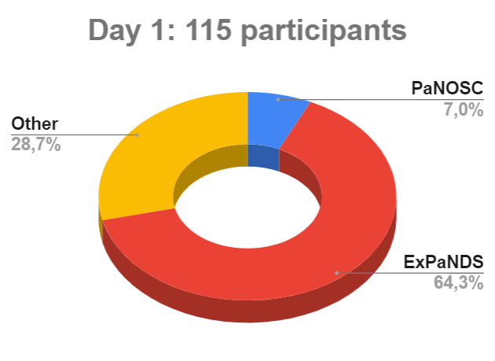

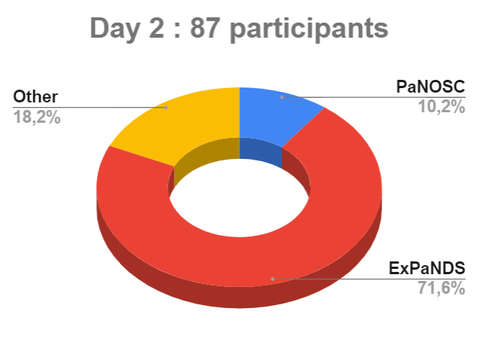
First training event: FAIR workshop (01-02/10/2020)
Target Audience | Objectives
Instrument scientists and other facility staff | Overview of FAIR – key questions related to the data facilities produce Exploration of the FAIR experiment Receive feedback from audience
https://expands.eu/2020/09/09/expands-fair-workshops-1st-2nd-october-2020/

Slide 14
Upcoming events
Next workshops (topic to be defined by WP leaders) :
On-bording with EOSC (April 2021)
Data stewardship
Data catalogue
Data services
ONLINE FORMATS DUE TO THE COVID-19 SITUATION
«Train the trainer (TtT)» online workshop using the e-learning platform (beginning 2021)
Objectives: Develop onboarding guidance for trainers and training modules, feedback on platform
Trainers: Jesper Bruun, Department of Science Education, UCPH & Victor L. Holm, Niels Bohr Institute, UCPH
Duration and scope: 3 + 2 days during winter with hands-on team work, developing actual courses for pan-learning.org.
Participants: Preferably one from each facility, although max 24.
CONTRIBUTION FROM TECHNICAL WPs NEEDED
CALL FOR PARTICIPANTS
(one per facility)

Slide 15
Past and foreseen engagement with users, other initiatives and stakeholders

Slide 16
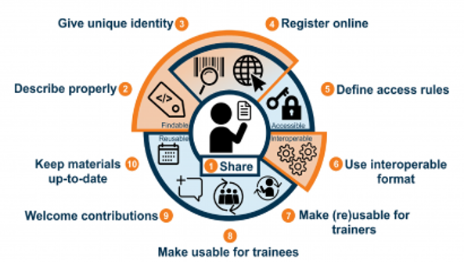

Ten simple rules for making training materials FAIR
Observation 1: FAIR for training good practices required
Guidelines which apply the FAIR principles to limitation experienced by trainers looking to find, (re)use and adapt learning materials.
Guidelines pertinent across domain and include amongst others:
Plan to share your training materials online
Give your training materials a unique identity
Make your training materials contribution friendly
Improve findability of your training materials by properly describing them
Garcia et al. (2020) Ten simple rules for making training materials FAIR. PLoS Comput Biol 16(5): e1007854. https://doi.org/10.1371/journal.pcbi.1007854

Slide 17
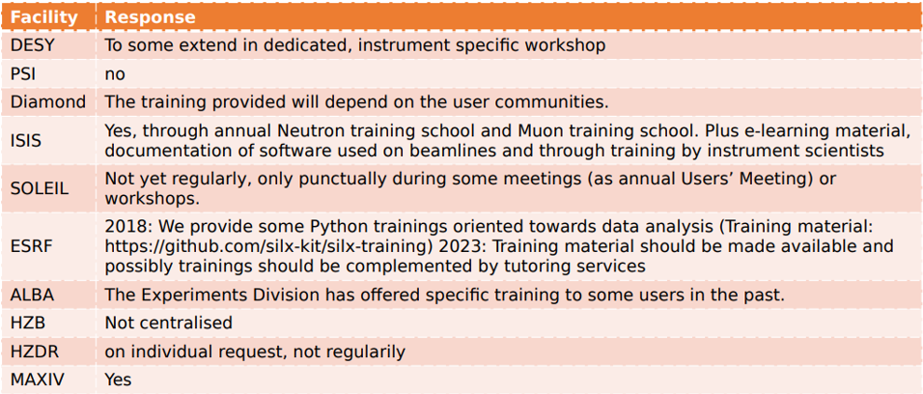
Observation 2: Need to centralise the access of available training material in PaN facilities?
Many scattered existing training materials
How to centralise and index all of them ?
Stolen from the survey done for the WP4 technical workshop organized by ExPaNDS and PaNOSC

Slide 18
Ambition: Provide a training portal dedicated to PaN community
Objectives of the future PaN training portal:
will be a single entry point to relevant training ressources for the PaN community
will include the e-learning platform to create training material.
will be a catalogue of centralized PaN dedicated training resources (material and events), adopting FAIR principles.
will contribute to a growing EU PaN dedicated training catalogues
will be an effective gateway to find and share training events and ressources for the PaN community
will be sustainable beyond the timeframe of the projects to serve users in the long-term in terms of technology, maintenance, and business model
Future work on collecting the material and events, and on metadata definition to index the training content.

Slide 19

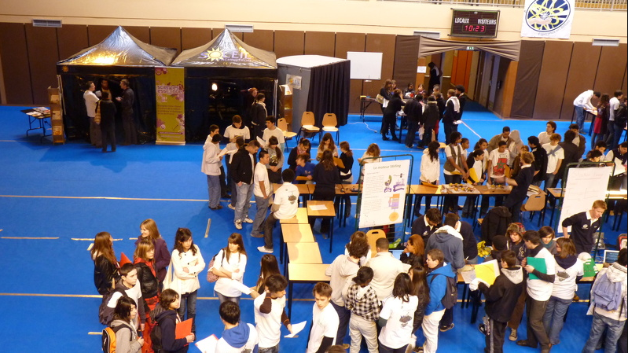

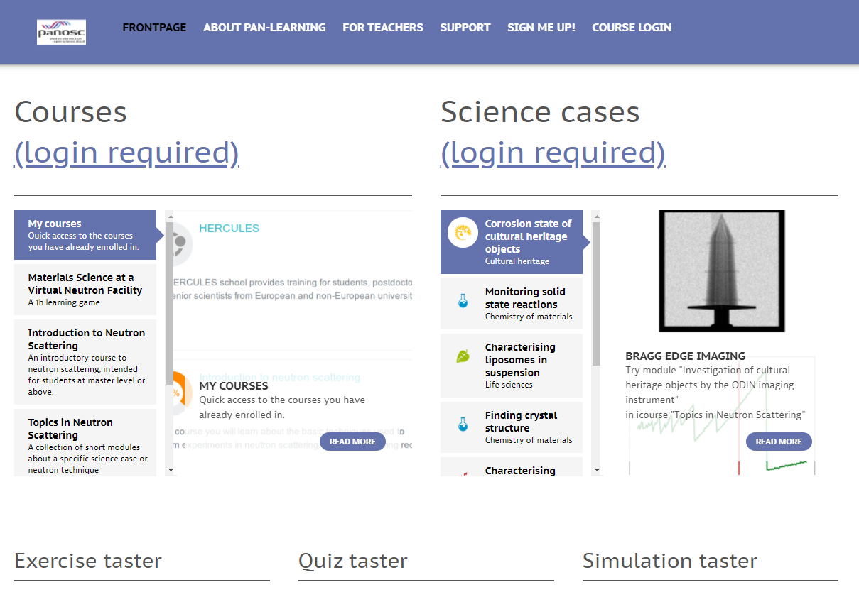
PaN training portal
Ambition
Training events
Catalogue of training events of interest for the PaN community (Online and f2f events)
Workshops, MOOCs, summer schools, online courses, webinars…
Training material
Catalogue of training materials of interest for the PaN community
External links to content provider’s website or repositories as Github, GitLab, Zenodo, Open Aire, etc
E-learning platform
Tool available to create and store training material
Moodle with Jupyter integration
Simulation tools
MediaWiki

Slide 20
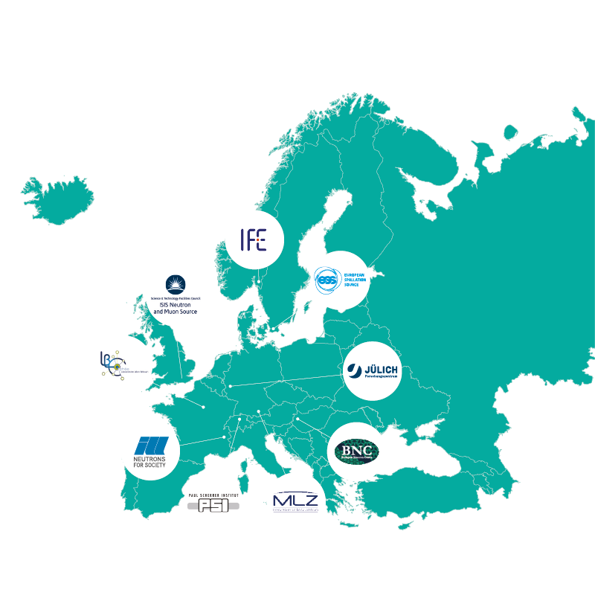
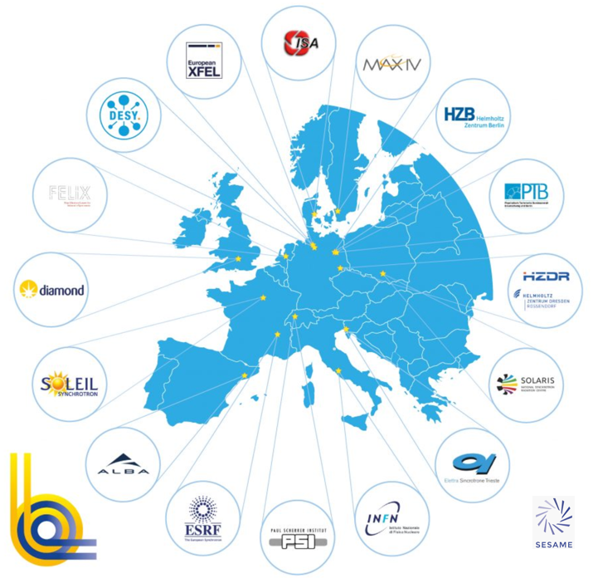



Sustainability: PaN facilities covered by PaNOSC/ExPaNDS
Photon (LEAPS)
PaNOSC
Neutron (LENS)
ExPaNDS
DESY
CESNET
STFC
Source: Helmut Dosch

Slide 21
















Sustainability: Engagement with other initiatives and Stakeholders
ESFRI cluster projects
Sharing of good practices
INFRAEOSC -5B projects
Promote adoption and sustainability

Slide 22
Next steps for the upcoming 12 months

Slide 23
Next steps for the upcoming 12 months
CONTRIBUTION FROM OTHER WPs NEEDED!
Establishing a strong relation with key stakeholders within and outside the projects is crucial to the future adoption and sustainability of the platform
Technical developments: Jupyter integration in the e-learning platform, PaN portal prototype
Identification of training contact points at each facility to promote platform adoption and addition of new content
Organisation of the Train the Trainer workshop (beginning 2021) and the onboarding with EOSC workshop (April 2021)
Definition of training objectives and development of training content : Survey to be sent to PaNOSC and ExPaNDS partners (Dec. 2020)
Provide guidelines to create training material and to use the training platform
Adoption and sustainability: Contact with LEAPS, LENS, LASERLab

